Slide 1


Project HYPACT
Cracking of green ammonia to hydrogen ​
using innovative catalyst and adsorbent-assisted plasma technology​
​

Slide 2
Alternative hydrogen carriers
Compressed hydrogen (C-H₂)
Liquid hydrogen (L-H₂)
LOHC
MCH
(Di)BT
HydroSil
KBH₄
Hydrogen derivatives
Methanol
methane
Notes:
To determine if ammonia is still the best hydrogen carrier an extensive literature study has been composed, investigating several parameters of alternative hydrogen carriers and comparing them with ammonia. The list above were the main competitors.

Slide 3
Available hydrogen Carriers
Hydrogen Carrier | C-H₂ | L-H₂ | MCH | DiBT | NH₃
Energy consumption conversion to carrier (kWh/kg H2)
Energy consumption conversion to hydrogen (kWh/kg H2)
Hydrogen content (kg H₂ per m³)
Purity of H₂ after dehydrogenation
TRL
Direct use
Good
Bad
Notes:
The main competitors of ammonia are listed again and compared using a colour scale.
The first parameters are the energy consumptipon for the conversion to the carrier and conversion back to hydrogen. These parameters indicate how efficient it is to use this carrier as all energy used for conversion is lost in the end.
The second parameter is the volumetric hydrogen content, indicating how much hydrogen can be stored per cubic meter. The less space the less space needed to store hydrogen the more hydrogen can be carried at a time on a ship.
Next up is the purifty of hydrogen after the dehydrogenation process. This was however not significantly different except for compressed hydrogen as this is 100% hydrogen after decompressing.
The TRL level indicates the entire value chain. Parts of the value chain can be at TRL 9, but if there is a part (like ammonia cracking) that is not at TRL 9, the parameter will not be dark green.
Finaly the direct use of a carrier is also investigated. If a carrier can be used directly it does not require the energy for (de)hydrogenation as well as a purification process afterwards.

Slide 4
Available hydrogen Carriers
Hydrogen Carrier | C-H₂ | L-H₂ | MCH | DiBT | NH₃
Flammability/ explosiveness
Toxicity
Environmental impact
Health dangers
Most toxic/ dangerous for humans
Good
Bad
Notes:
Safety has also been investigated. Most carriers are very flammable and easy to ignite which can create explosions. Ammonia however is very difficult to ignite so has a low risk for explosiveness. On the other hand it is very toxic and dangerous for human health. The other carriers are less dangerous for humans, but MCH and DiBT are both also toxic.

Slide 5

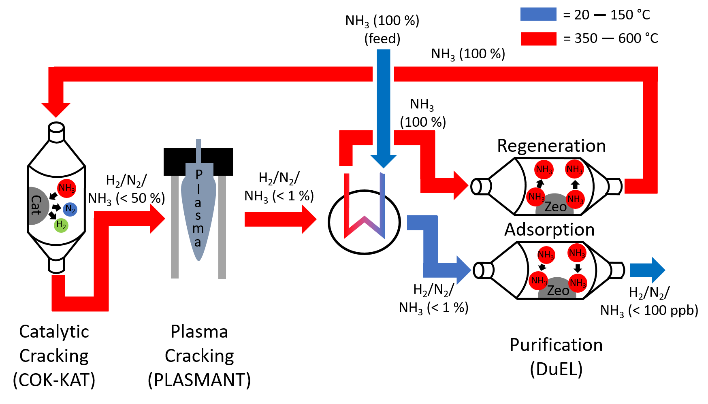


HyPACT project scheme
Coordination
(WaterstofNet)

Slide 6
Project boundary conditions & aims
Boundary conditions
Input: Liquid NH₃ at 1 bar
Output: H₂ product at 50 bar
Aims
Non-noble abundant metal catalyst
NH₃ in H₂ product gas < 100 ppb
Target energy cost ≤ 75 kJ.mol_{NH3}⁻¹
(x0.09) ≤ 6.94 kWh.kg_{H2}⁻¹
NH₃ Conversion ≥ 98%

Slide 7
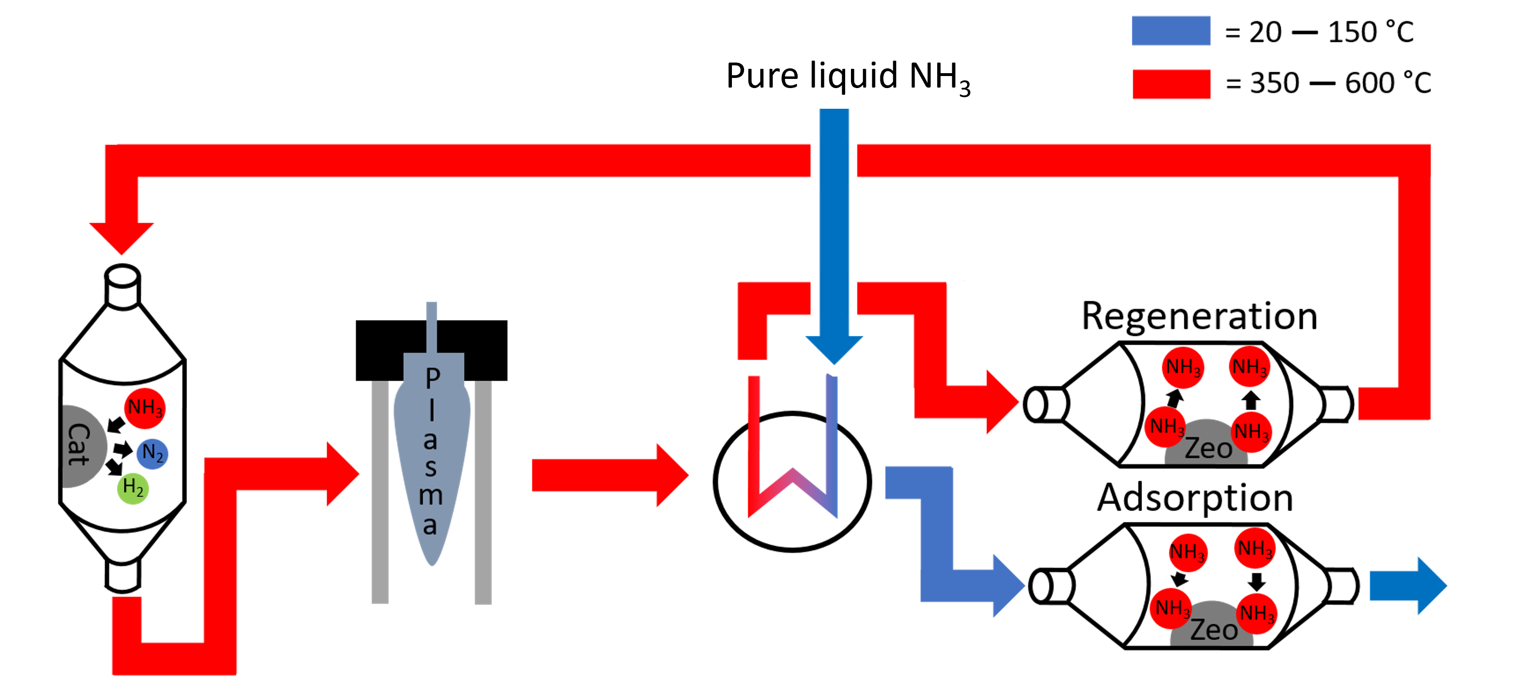
Smart heat integration of HyPACT
Heating & Evaporation
Energy need
Heat recovery
Heating reactor
Compression
Compression heat
Plasma cracking
* Purification has negligible energy cost
Plasma heat
Evaporation of feed
Heating of feed
Heating catalytic reactor
Regeneration of adsorbent
Heat from plasma
Heat from compression

Slide 8

Theoretical energy cost of HyPACT
5.5 bar
Compressor
Compressor
Optimum energy cost & pressure
= 71 kJ.mol_{NH3}⁻¹ @ 5.5 bar
Plasma
Plasma reactor
Source: own computations
Notes:
6.6 kWh/kg_{H2}

Slide 9

Project progress second year HyPACT
1. Catalyst development for pre-plasma process (COK-KAT)
2. Plasma reactor (PLASMANT)
3. Thermal swing adsorption (DuEl)
4. Process simulations (COK-KAT)
5. Virtual lab scale demonstration (DuEl)
6. Benchmarking (WaterstofNet)

Slide 10
1. Catalyst development for pre-plasma process

Slide 11

Ammonia cracking on Ru catalysts
Ru-alumina
Ru-K-alumina (batch 1)
Ru-K-alumina (batch 2)
Blank
Target noble metals:
X_{NH3} (450°C) > 70%
Ruthenium-based catalyst achieving
conversion > 70% at T < 450°C and a WHSV > 4 h⁻¹
Conditions: P= 1 atm; NH₃ flow rate 40 N mL/min; W_{cat}= 455 mg; WHSV = 4 h⁻¹, GHSV = 5271 mL g⁻¹ h⁻¹
4 h⁻¹ & 99% conversion
≈ 17 kg H₂ per kg catalyst per day

Slide 12
Development of precious metal-free catalyst
X_{NH3} (500°C) > 90%
Target non-noble metals:
X_{NH3} (500°C) > 50%
Precious metal-free catalyst achieving
conversion > 50% at T < 500°C and a WHSV > 4 h⁻¹
Conditions: P= 1 atm; NH₃ flow rate 40 N mL/min; W_{cat}= 455 mg; WHSV = 4 h⁻¹, GHSV = 5271 mL g⁻¹ h⁻¹

Slide 13
Recap of all self-made catalysts
Non-noble metal
Noble metals
Top non-noble metal-catalysts achieves target conversion of noble metal catalysts
Target conversion noble metals
Target conversion non-noble metals
Conditions: P= 1 atm; T=478°C; NH₃ flow rate 40 N mL/min; W_{cat}= 455 mg; 125-250µm; WHSV = 4 h⁻¹

Slide 14
Development of precious metal-free catalyst
Influence of pressure on catalyst performance
(max 7 barg in reactor)
Non noble metal catalyst
Noble metal catalyst
Δ ≈ 20°C
Δ ≈ 30°C
Effect of pressure differs between different catalysts
Conditions: NH₃ flow rate 40 N mL/min; W_{cat}= 455 mg; WHSV = 4 h⁻¹, GHSV = 5271 mL g⁻¹ h⁻¹

Slide 15
Long-term stability testing
Unused catalyst with variation in temperature:
Long-term test after 2 weeks of testing:
0.1%
615°C
515°C
615°C
515°C
515°C
→ Nitridation of catalyst increases the activity
Conditions: P= 1 atm; NH₃ flow rate 40 N mL/min; W_{cat}= 455 mg; WHSV = 4 h⁻¹, GHSV = 5271 mL g⁻¹ h⁻¹

Slide 16
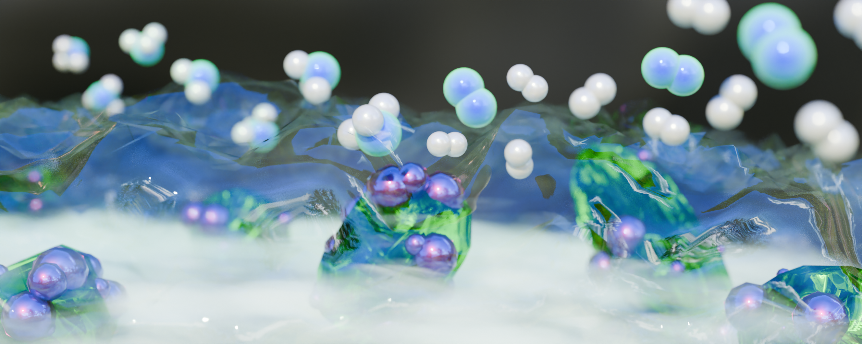
Present perspective Future perspectives
Development of highly active & stable non-noble metal catalysts
Testing catalysts at higher pressure for implementation in Aspen model
Understanding of the mechanism on the non-noble metal catalyst

Slide 17
2. Plasma reactor

Slide 18
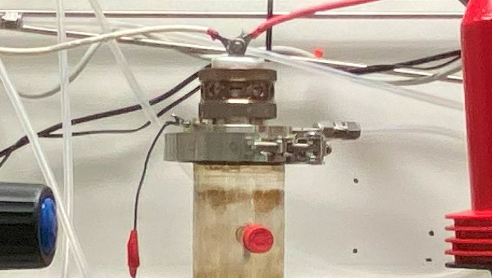
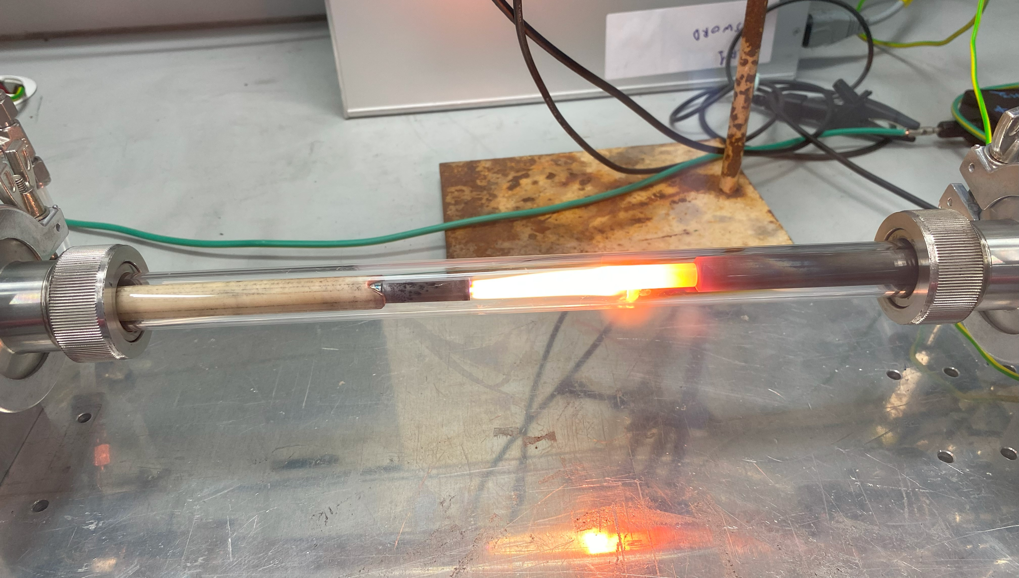
Plasma reactors for NH₃ cracking
4 different reactors were thoroughly evaluated [1]
2 most promising:
Reactor | Gliding arc plasmatron (GAP) | Pin-to-pin arc discharge (P2P)
Feed flow rate | 10 – 20 Ln/min | 10 – 20 Ln/min
Plasma power | 255 – 890 W | 115 – 445 W
Achieved HyPACT conversion | 99 % | 94 %
 | Best plasma reactor selected after 1st year of HyPACT | New plasma reactor Simpler design with easier heat recovery
[1] Igor Fedirchyk, Ivan Tsonev, Rubén Quiroz Marnef and Annemie Bogaerts, “Plasma-assisted NH₃ cracking in warm plasma reactors for green H₂ production”, Chemical Engineering Journal, vol. 499, p. 155946, doi: 10.1016/j.cej.2024.155946.

Slide 19
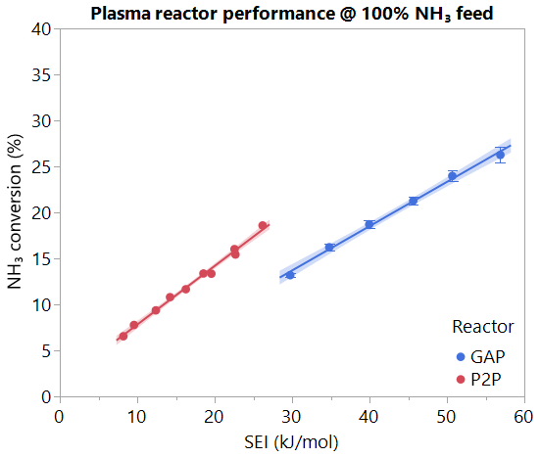
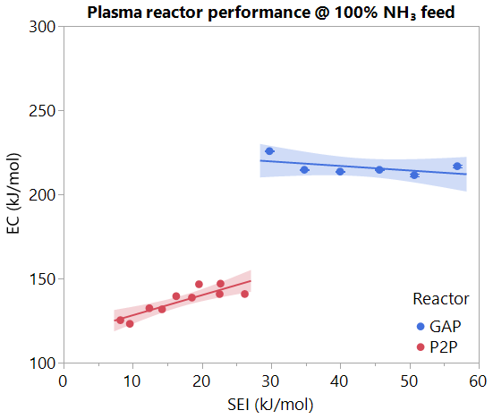
New plasma reactor for NH₃ cracking: P2P arc
P2P: measured plasma temperature is ~ 3700 ⁰C
P2P: 30 % more efficient than GAP with 100 % NH₃ feed
Best performing reactor among those tested for HyPACT
Ref: Igor Fedirchyk, Ivan Tsonev, Rubén Quiroz Marnef and Annemie Bogaerts, “Plasma-assisted NH₃ cracking in warm plasma reactors for green H₂ production”, Chemical Engineering Journal, vol. 499, p. 155946, doi: 10.1016/j.cej.2024.155946.

Slide 20
Comparison with state of the art
HyPACT reactors are among the best performing plasma reactors for NH₃ cracking
P2P: lowest EC among known plasma reactors when cracking 100 % NH₃ feed: 120 kJ/mol
Figure adapted from: Igor Fedirchyk, Ivan Tsonev, Rubén Quiroz Marnef and Annemie Bogaerts, “Plasma-assisted NH₃ cracking in warm plasma reactors for green H₂ production”, Chemical Engineering Journal, vol. 499, p. 155946, doi: 10.1016/j.cej.2024.155946.

Slide 21
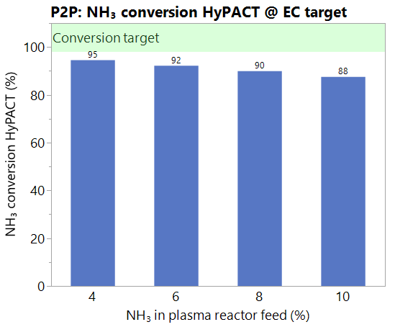
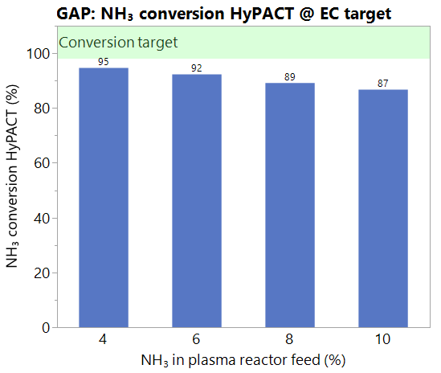
Plasma reactors: P2P vs GAP conversion @ target EC
EC HyPACT target (56 kJ/mol) was achieved for all feed compositions
P2P arc reactor provides 1 % higher total NH₃ conversion in HyPACT for the feeds with higher concentration of NH₃ (8 % and 10 %) → 5-10 % improvement over GAP reactor
To reach target NH₃ conversion in HyPACT (98 %) we must double conversion in plasma
Can be done by resolving the main issue: part of NH₃ feed passes reactor without contact with plasma

Slide 22
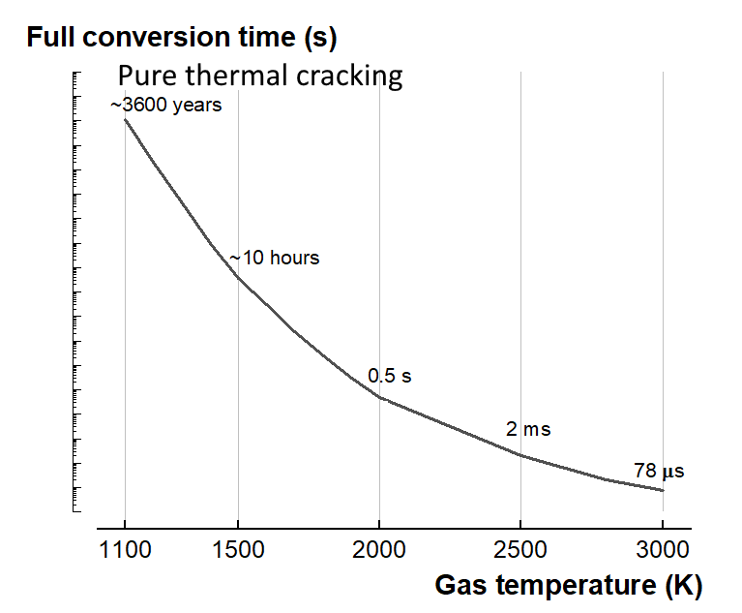
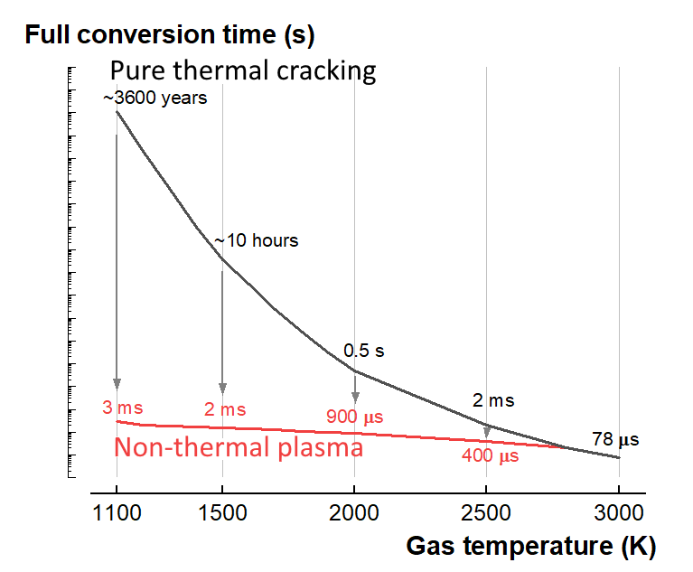
Plasma modelling: efficient operating conditions
Thermal ammonia cracking is a very slow process
Plasma decreases conversion time
Non-thermal plasma (= electron-induced chemistry): high EC
Warm plasma: fast + lower EC (120 kJ/mol), cf. slide 20
Plasma chemistry: many reactions ⇒ Complex chemistry set
Computer simulations allow for understanding and improvement
Ideal operating regime!
Ref: "Modeling insights for plasma chemical kinetics in warm plasma NH₃ cracking", Seunghwan Bang, Stein Maerivoet, François Reniers and Annemie Bogaerts, submitted to Green Chemistry Journal

Slide 23
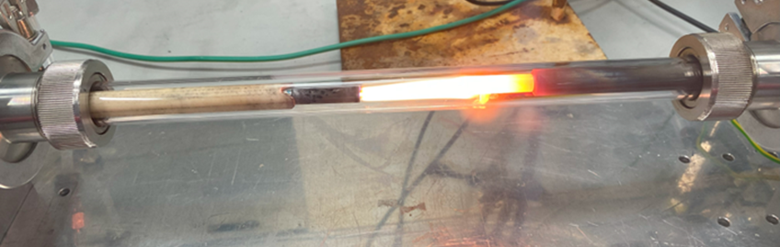
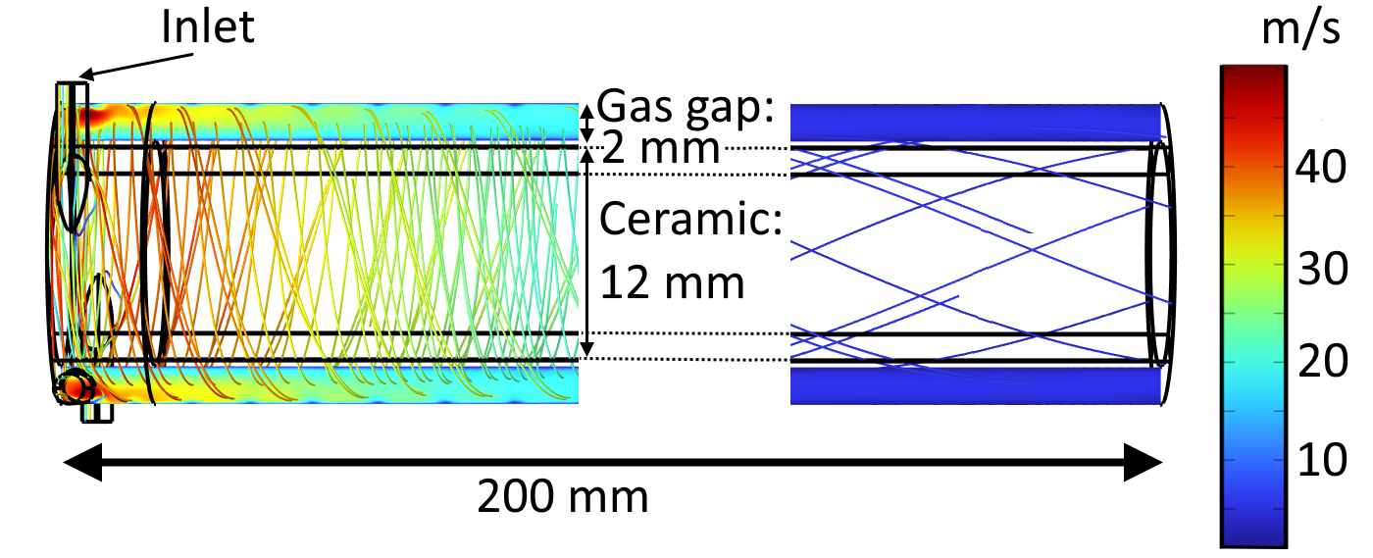
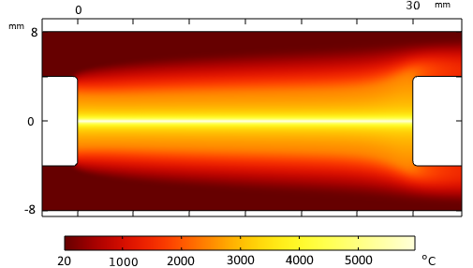
Plasma modelling: P2P reactor
Ref: "Spatially resolved modelling of NH₃ cracking in warm plasma ", Rubén Quiroz Marnef, Stein Maerivoet, Ivan Tsonev, François Reniers and Annemie Bogaerts, submitted to Chemical Engineering Journal
Glowing electrode
Temperature profile
Flow profile around ceramic holder for electrode pin
High-voltage
Electrode
Ground
Electrode
Initial strong vortex flow
Steadily decays into laminar flow over 150 mm
5600 °C plasma arc
Surrounded by cold unreacted gas

Slide 24
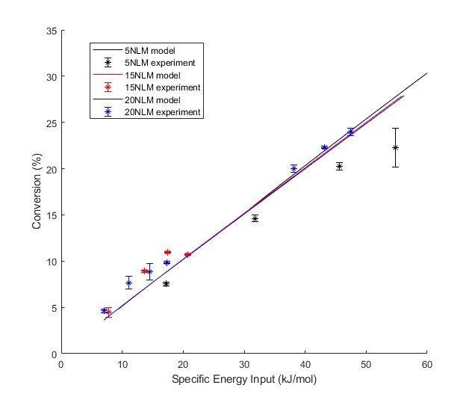
Plasma modelling: model vs experiment
Thermal model captures main experimental trends
NH₃ conversion is efficiently driven by thermal chemistry
Ref: "Spatially resolved modelling of NH₃ cracking in warm plasma ", Rubén Quiroz Marnef, Stein Maerivoet, Ivan Tsonev, François Reniers and Annemie Bogaerts, submitted to Chemical Engineering Journal
Specific Energy Input = Power/Flow Rate

Slide 25
3. Thermal swing adsorption

Slide 26

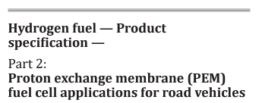

Design of an adsorption-based purification step
Main goals
PEM Fuel cell quality H₂ stream: < 0,100 ppb to avoid cell electrodes poisoning
In full heat integration: make use of the thermal heat (plasma & thermocatalytic steps) available for the regeneration cycle
Recover the residual ammonia and send back to the cracker
Using commercially availables zeolites
Methodology
Screening of zeolites for optimal NH₃ sorption (equilibrium & usable)
Experimental characterization of the isotherms
Experimental characterization of the breakthrough curves
Design of a Temperature Swing Adsorber (TSA)

Slide 27
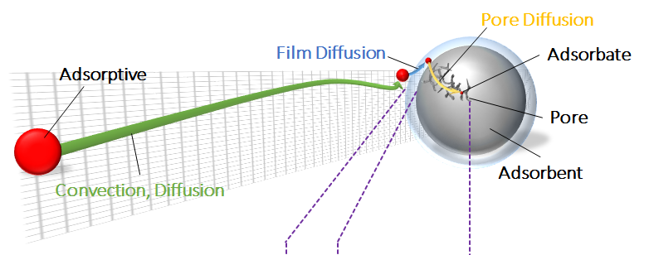
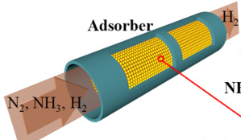


Material screening: Equilibrium & dynamic loading (D3.2.1)
Mole sieves (3-5A, 13X) & Y-zeolites (CBV40-760, including pelletized)
Pressure between 0,1 & 2,5 bar; Temperature between 10 & 50 °C
$$r_{ads}=k_{LDF}\left(q_{eq}−q\right)$$
$$q_{eq}=IP_{1}\exp\left(\frac{IP_{3}}{T}\right)P_{NH3}^{IP_{2}}$$
Notes:
Isosteric heat 11 – 20 kJ/mol
Isotherm modem less than 2% deviation

Slide 28
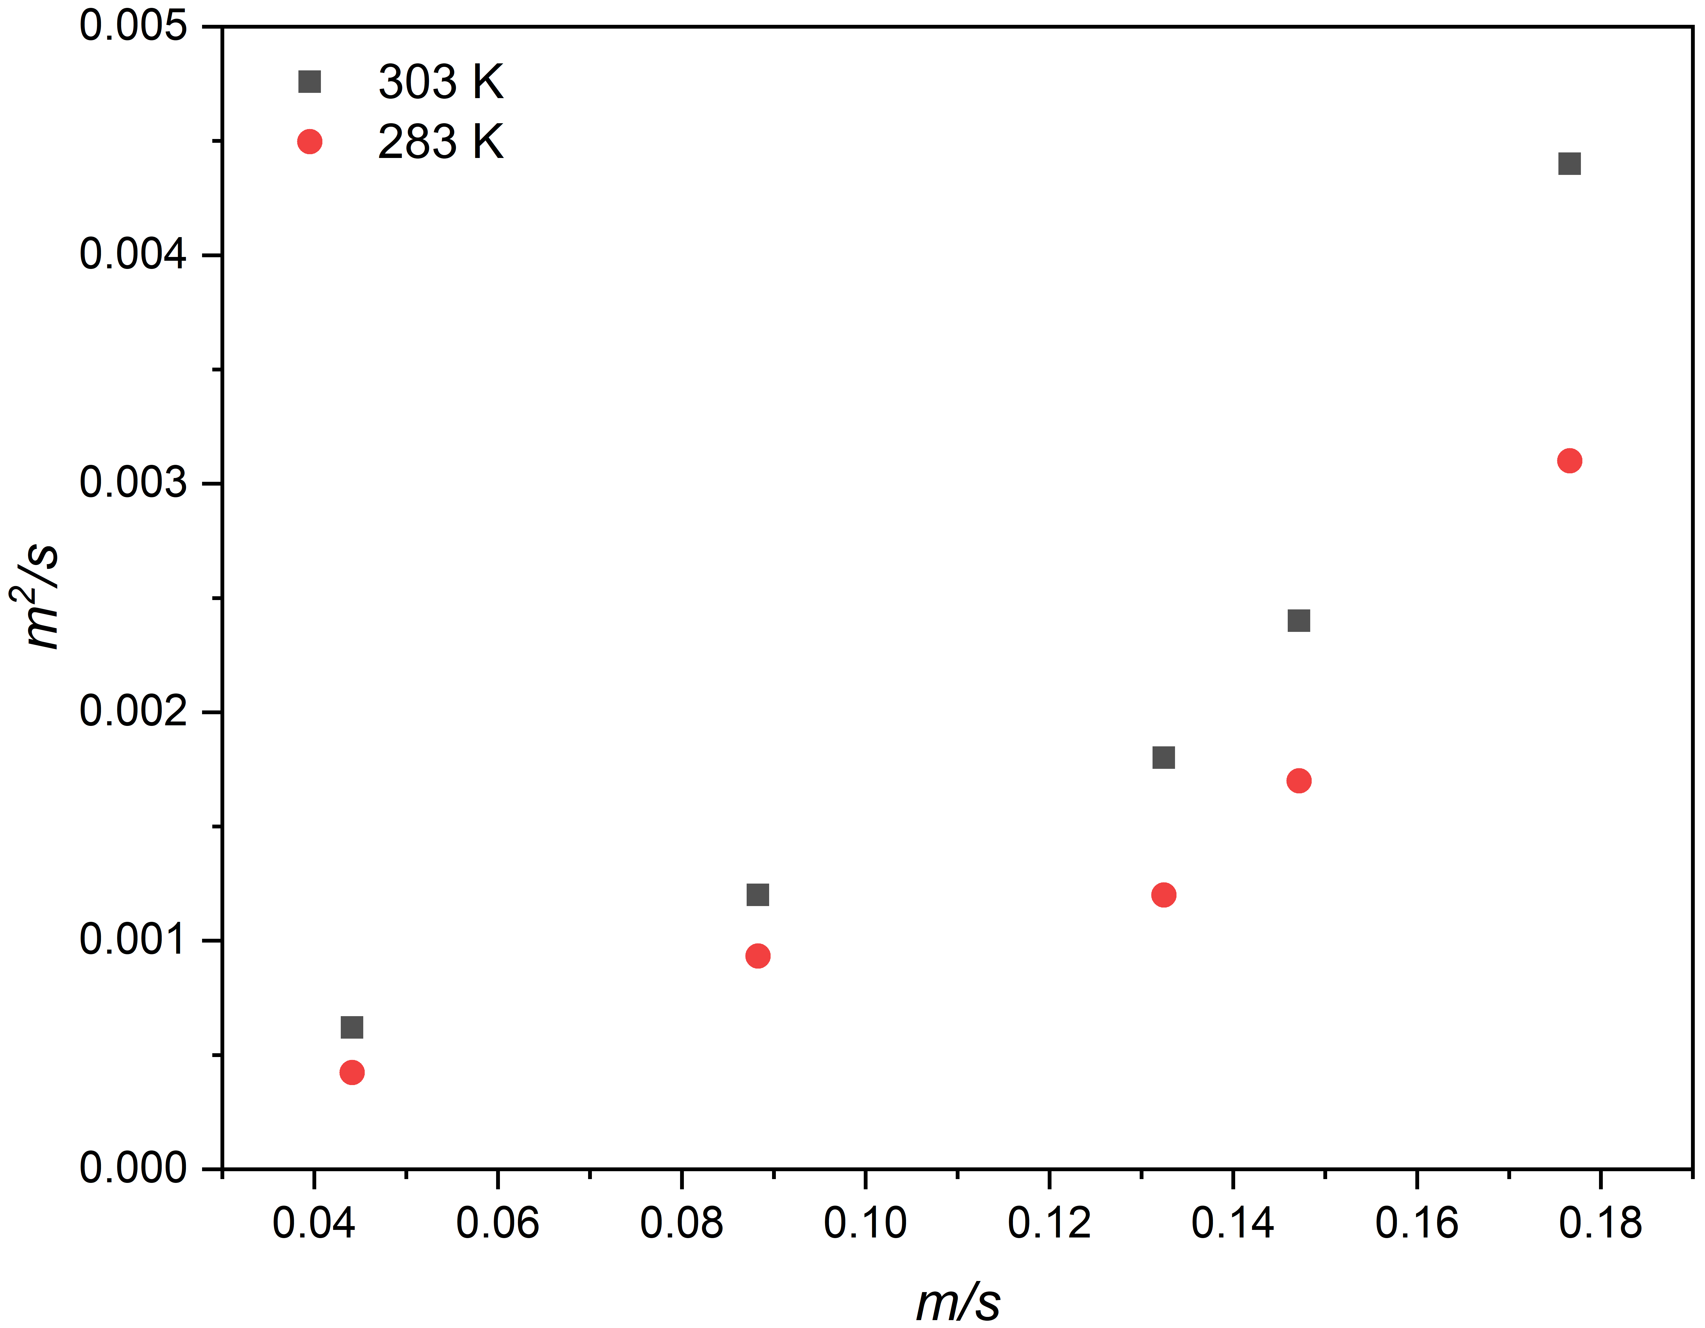
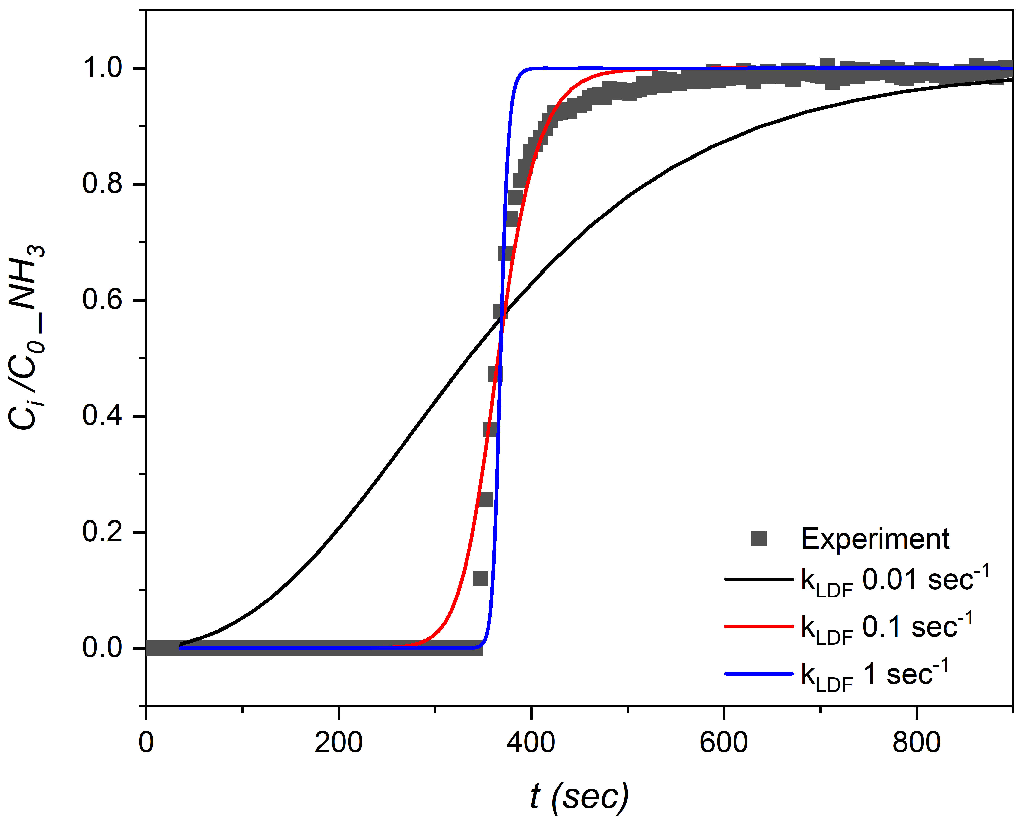
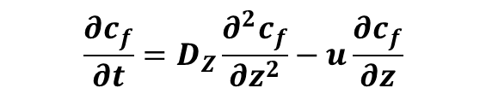
TSA design from dynamic loading experiments
Convection-dispersion model (NH₃ adsorption)
Effective axial dispersion from step change from an inert gas tracer (He)
$$\frac{∂c_{f}}{∂t}=D_{Z}\frac{∂^{2}c_{f}}{∂z^{2}}−u\frac{∂c_{f}}{∂z}$$
$$\frac{∂c_{f}}{∂t}=D_{Z}\frac{∂^{2}c_{f}}{∂z^{2}}−u\frac{∂c_{f}}{∂z}−\frac{\left(1−ε\right)}{ε}{ρ_{p}k}_{LDF}\left(q_{e}−q\right)$$
From inert tracer experiments
Effect of the setup PLUS the QMS
Effective axial dispersion (D_{z})
Normalized breakthrough function
Superficial gas velocity (u)

Slide 29
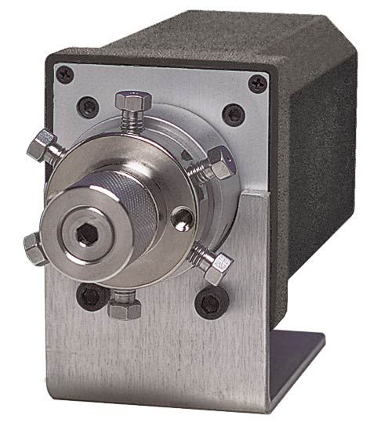
Mechanical design of the TSA system

Slide 30
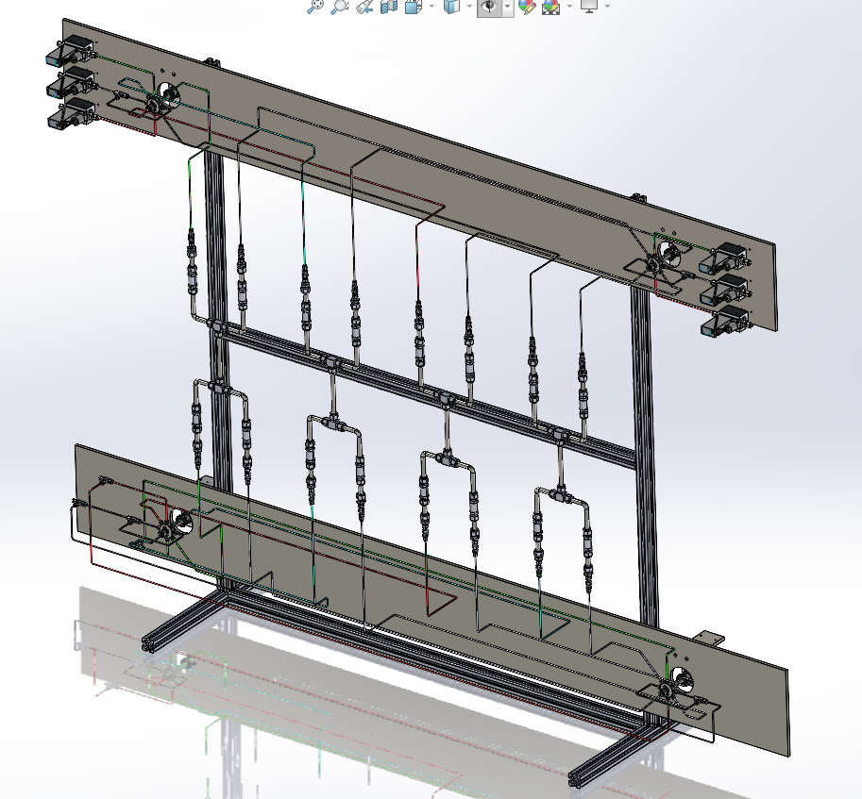
Mechanical design of the TSA system (D3.3.1)
Preliminary view
Without thermal insulation
Gas preheating not visible
Four 10 mmID, 20 cm long columns
5 Nl/min: 1% NH₃ to 0,1 ppb
Up to 10 g of sorbent
12-25 min adsorption cycles
System delivery:
December 12, 2024
Fully enclosed & connected to HVAC (ammonia & H2…)
WDH: 2,5 m × 0,7 m × 1,7 m
SOP in preparation

Slide 31
4. Process simulation

Slide 32

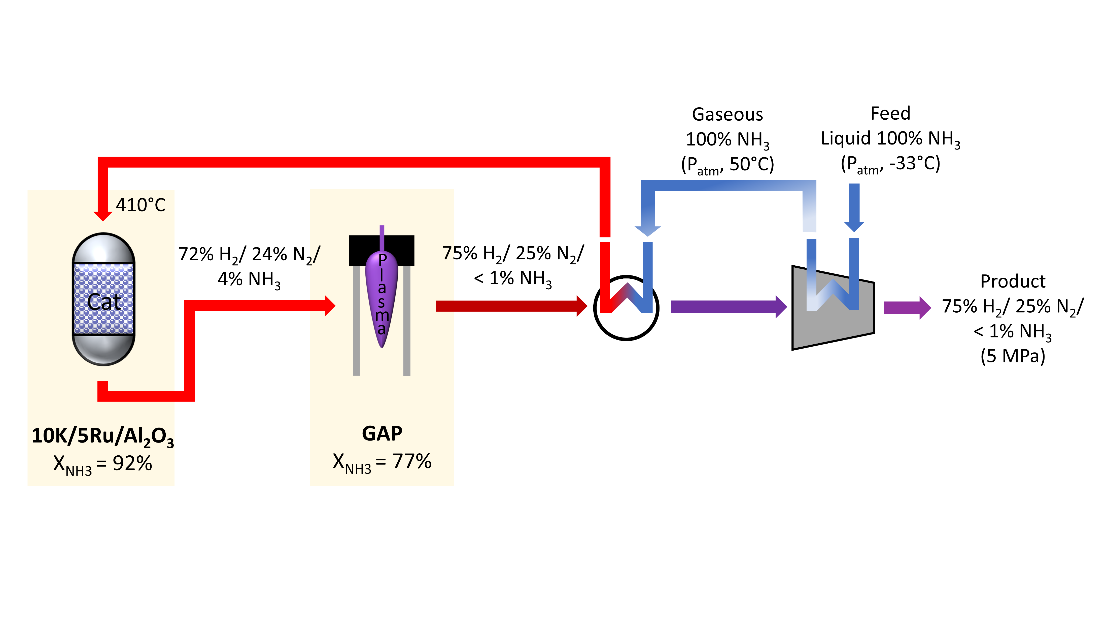
Refining and actualization of the Aspen model
based on experimental data
Total conversion = 98.2%
Ref: Frea Van Steenweghen, Annabel Veschueren, Igor Fedirchyk, Johan A. Martens*, Annemie Bogaerts, and Lander Hollevoet, “Reversed Plasma Catalysis Process Design for Efficient Ammonia Decomposition”, ACS Sustainable Chemistry & Engineering, vol. 13 (2), p. 737-743, DOI: 10.1021/acssuschemeng.4c08899

Slide 33
Refining and actualization of the model
based on experimental data
Ref: Frea Van Steenweghen, Annabel Veschueren, Igor Fedirchyk, Johan A. Martens*, Annemie Bogaerts, and Lander Hollevoet, “Reversed Plasma Catalysis Process Design for Efficient Ammonia Decomposition”, ACS Sustainable Chemistry & Engineering, vol. 13 (2), p. 737-743, DOI: 10.1021/acssuschemeng.4c08899

Slide 34
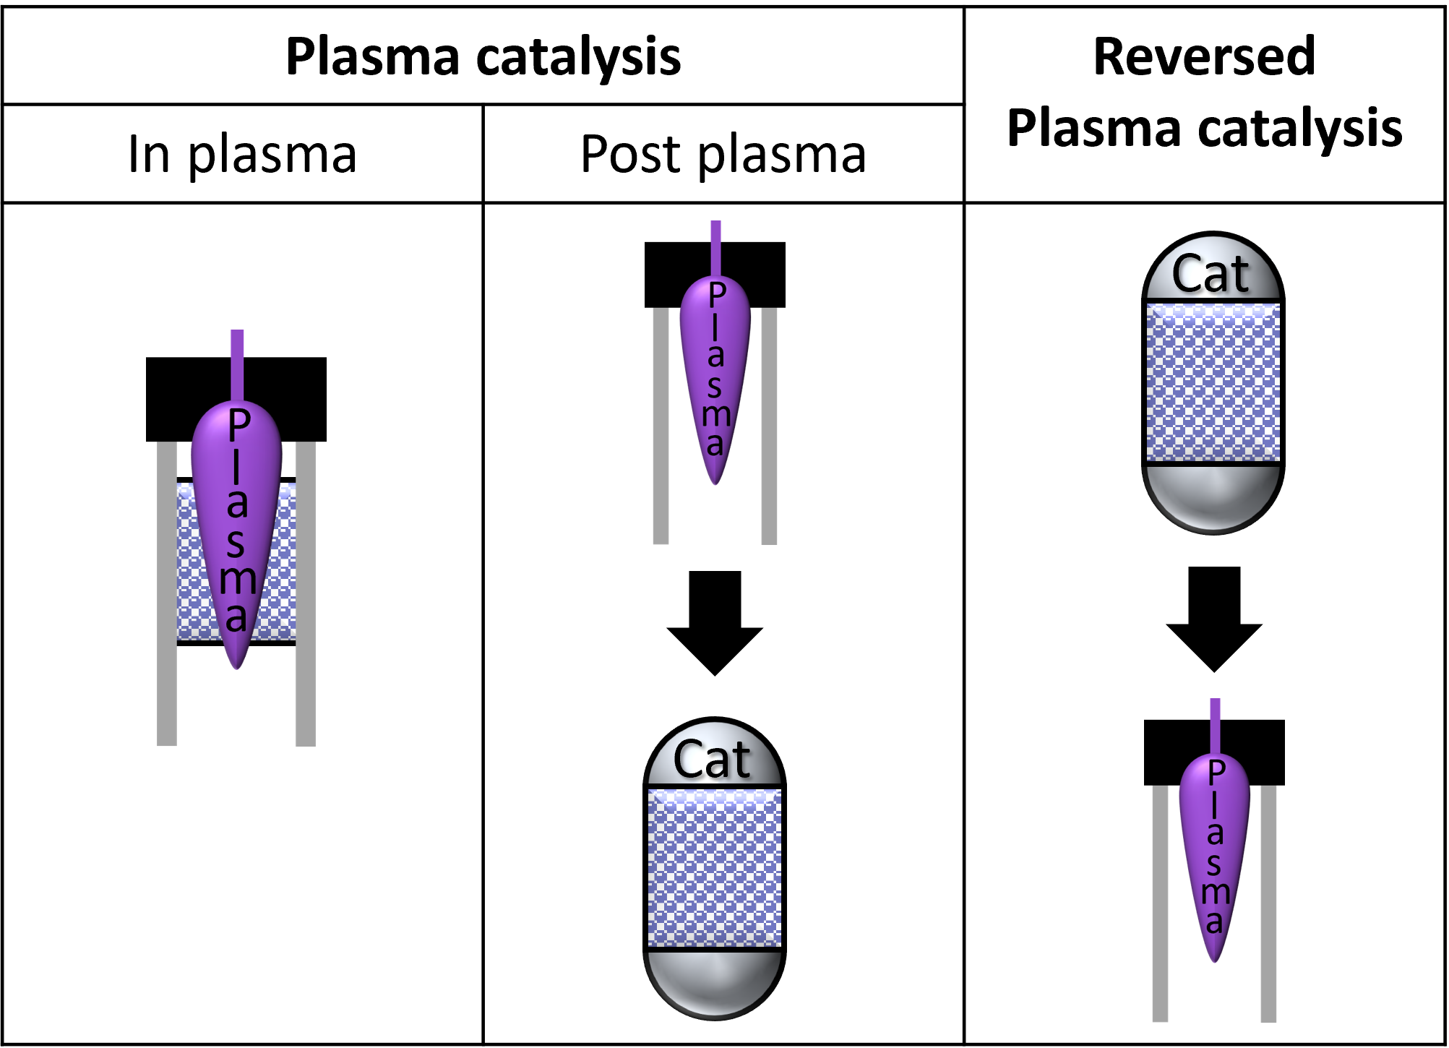
Exploring alternative process configurations
Comparison with Plasma catalysis
at same conditions & same catalyst/plasma type
 | Plasma catalysis (post-plasma) | Reversed plasma catalysis
NH₃ conversion | 98.2% | 98.2%
T_{reactor} [°C] | 410 | 410
P_{reactor} [bar] | 1 | 1
P_{product} [bar] | 50 | 50
Energy use [kJ.mol_{NH3}⁻¹] | 128 | 136
Exergy use [kJ.mol_{NH3}⁻¹] | 60.4 | 60.5
Catalyst need [g_{cat}.h.mol_{NH3}⁻¹] | 8.8 | 3.9
Lab experiments
& Aspen simulation
Our process
Ref: Frea Van Steenweghen, Annabel Veschueren, Igor Fedirchyk, Johan A. Martens*, Annemie Bogaerts, and Lander Hollevoet, “Reversed Plasma Catalysis Process Design for Efficient Ammonia Decomposition”, ACS Sustainable Chemistry & Engineering, vol. 13 (2), p. 737-743, DOI: 10.1021/acssuschemeng.4c08899

Slide 35
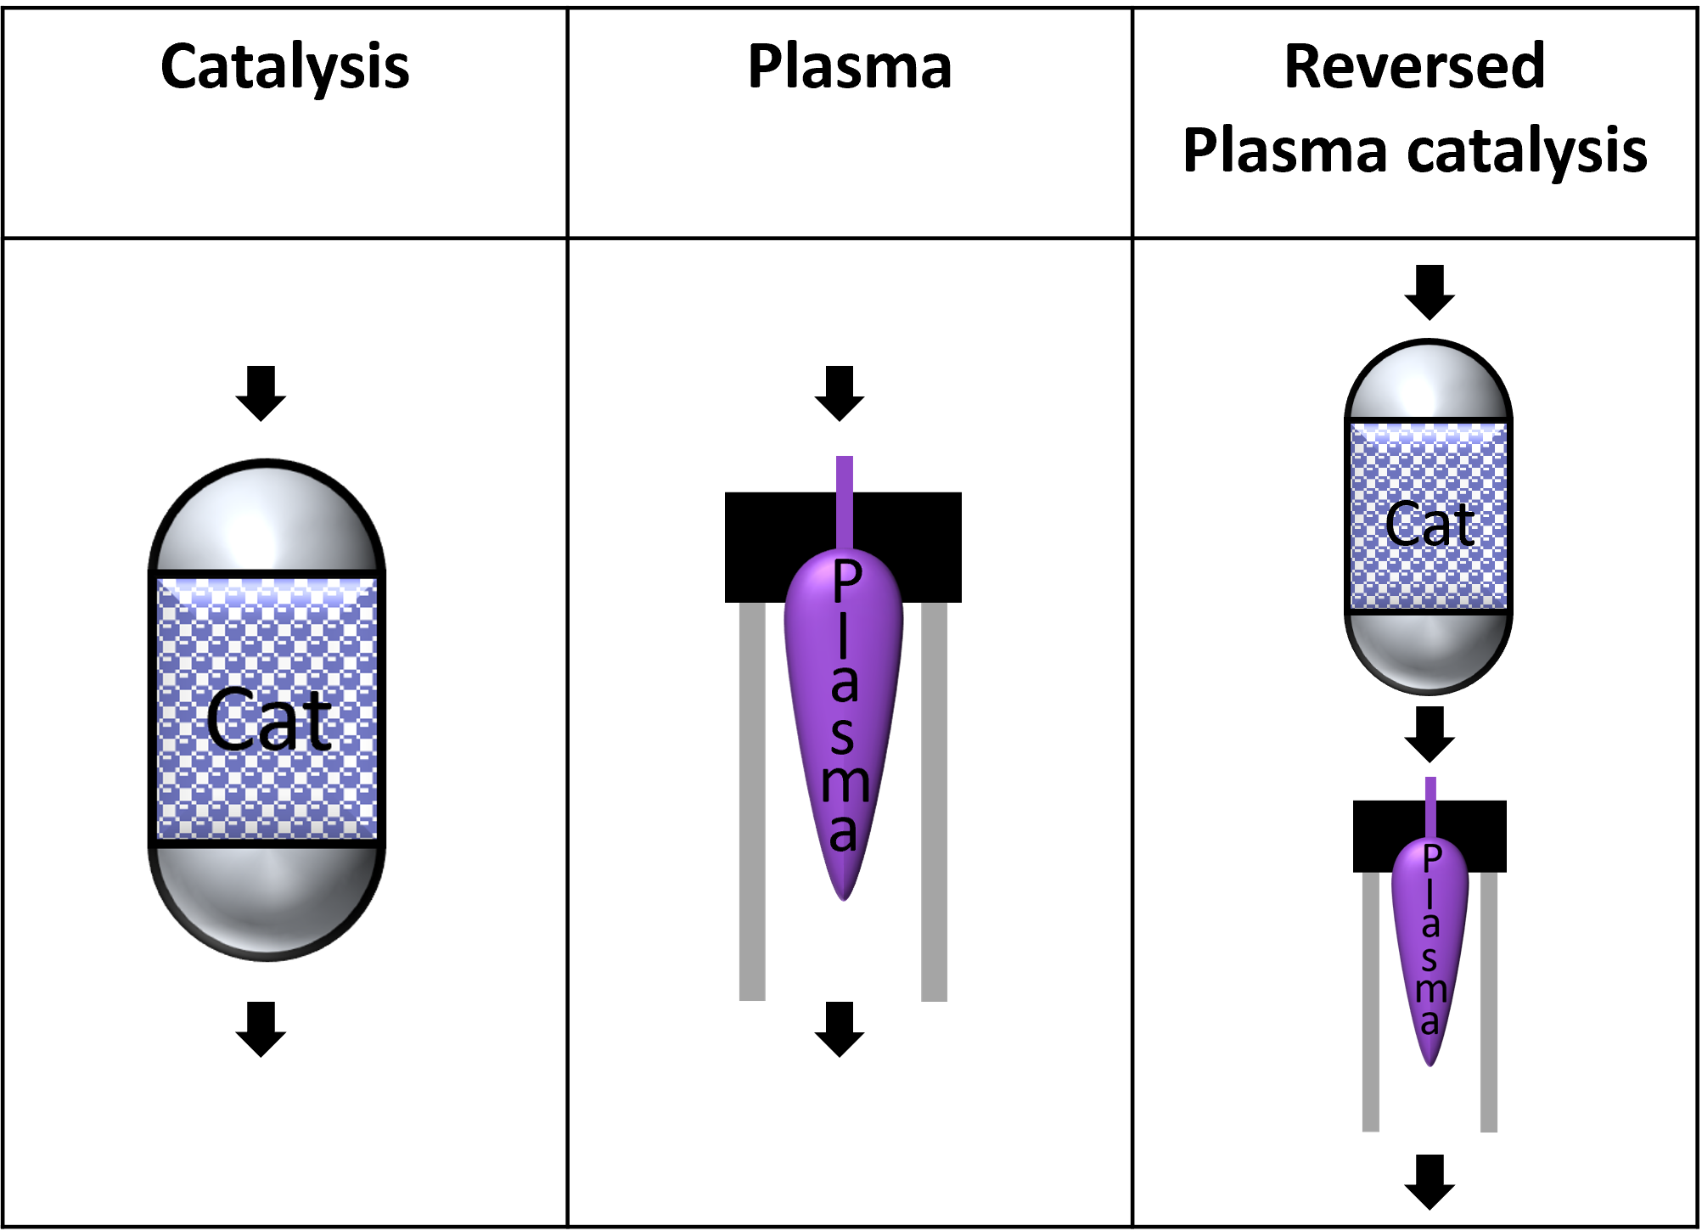
Comparison with other process configurations
Single reactor configurations: catalysis & plasma
For reaching 98.2% conversion with same catalyst/plasma type
Net energy consumption
Single GAP plasma does not reach 98% conversion
Catalyst use
Net exergy consumption
3x more catalyst needed for single thermocatalysis
Ref: Frea Van Steenweghen, Annabel Veschueren, Igor Fedirchyk, Johan A. Martens*, Annemie Bogaerts, and Lander Hollevoet, “Reversed Plasma Catalysis Process Design for Efficient Ammonia Decomposition”, ACS Sustainable Chemistry & Engineering, vol. 13 (2), p. 737-743, DOI: 10.1021/acssuschemeng.4c08899

Slide 36
Theoretical vs experimental energy cost
Improvement of plasma efficiency
Increasing operating pressure
Future perspectives
Implementation of non-noble metal catalyst
Implementation of data at higher operating pressure

Slide 37
5. Virtual lab scale demonstration

Slide 38
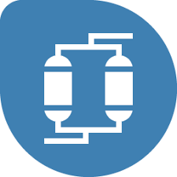
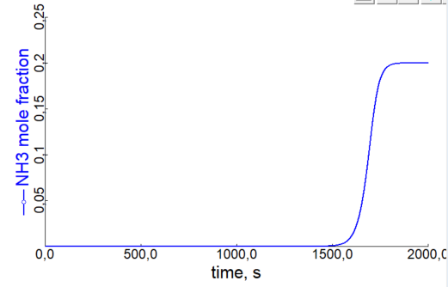
Integration of the TSA model in Process model
Integration of the TSA in the overall process model
TSA model using Aspen Adsorption
Aspen Adsorption model
Increasing level of complexity
From validation in a simple system (IN+BED+OUT, breakthrough)
30 Nml/min, 20% NH3; 1,05 g
No axial dispersion
30 Nml/min, 20% NH3; 1,05 g

Slide 39
Numerical design of TSA model in the process model
To full cycling operation of the virtual TSA (2-20 Nl/min):
5 Nl/min @ 1% NH3 → 0,1 ppb (1×10⁻⁷ mol/mol)
Convection & pressure drop, adiabatic operation (gas & solid conduction), all properties constant
Cycle design
1 - Adsorption cycle
1 bar, 30 °C, maintain y_{NH3} below 0,1 ppb
2 – Heating
From 30 to 350 °C for the regeneration
Under pure hot ammonia
3 – Cooling
Back to 30 °C using an inert

Slide 40

Numerical design of TSA model in the process model
Cycle duration
1 - Adsorption cycle
yNH3 > 0,1 ppb @ t > 18,5 min ⇒ $∆t_{ads}=$ 18 min
2 – Heating
Using heated ammonia
3 – Cooling
Using an inert gas

Slide 41

Numerical design of TSA model in the process model
Cycle duration
1 - Adsorption cycle
yNH3 > 0,1 ppb for 18 min
2 – Heating
Temperature reaches 350 °C @ t ≅ 20 min
Ammonia flowrate returns to set point@ t = 19,7 min
$∆t_{regen}=$ 2 min
3 – Cooling
Using an inert gas

Slide 42

Numerical design of TSA model in the process model
Cycle duration
1 - Adsorption cycle
yNH3 > 0,1 ppb for 18 min
2 – Heating
Regeneration for 2 min
3 – Cooling
Back to $T_{ads}$ using an inert
Ammonia mole fraction to 1% in less than 1 min
Cooling in 3,3 min @ t = 1400 s (23,3 min)
$∆t_{cooling}=$ 4 min

Slide 43
Further optimizing
Refine the simulation & experimental validation
Numerical aspects, addition of valves & instruments, thermal insulation
Simulate the continuous 1-20 Nl/min setup
Adsorption is the critical part
6 columns, 30% sorbent loading

Slide 44
Testing heating and cooling cycles
Qreg

Slide 45
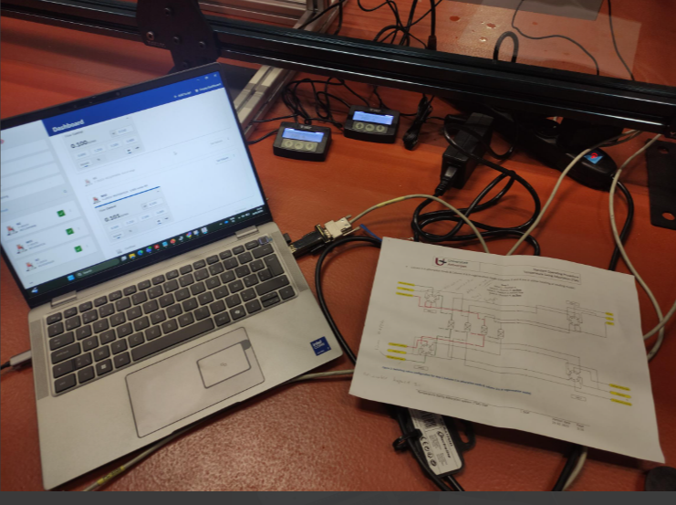
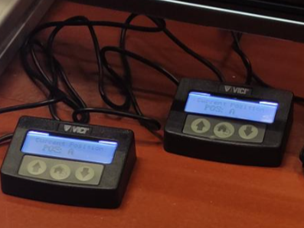
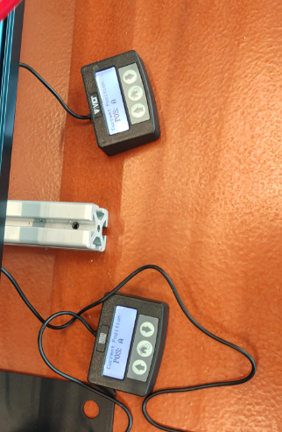
Testing flow and VICI valve activation-Step 1: Column 1 in adsorption and column 3 in regeneration mode.
Valves 1-3 Position A
Valves 2-4 Position A

Slide 46
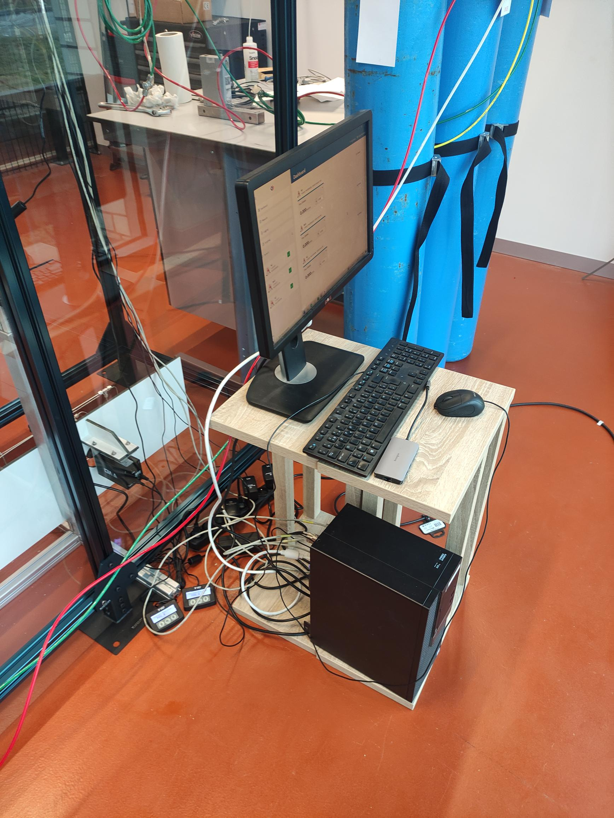
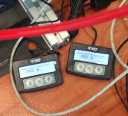
Testing flow and VICI valve activation-Step 3: Column 3 in adsorption and column 1 in regeneration mode.
Valves 1-3 Position B
Valves 2-4 Position A
The same procedure applies to steps 2 and 4.

Slide 47
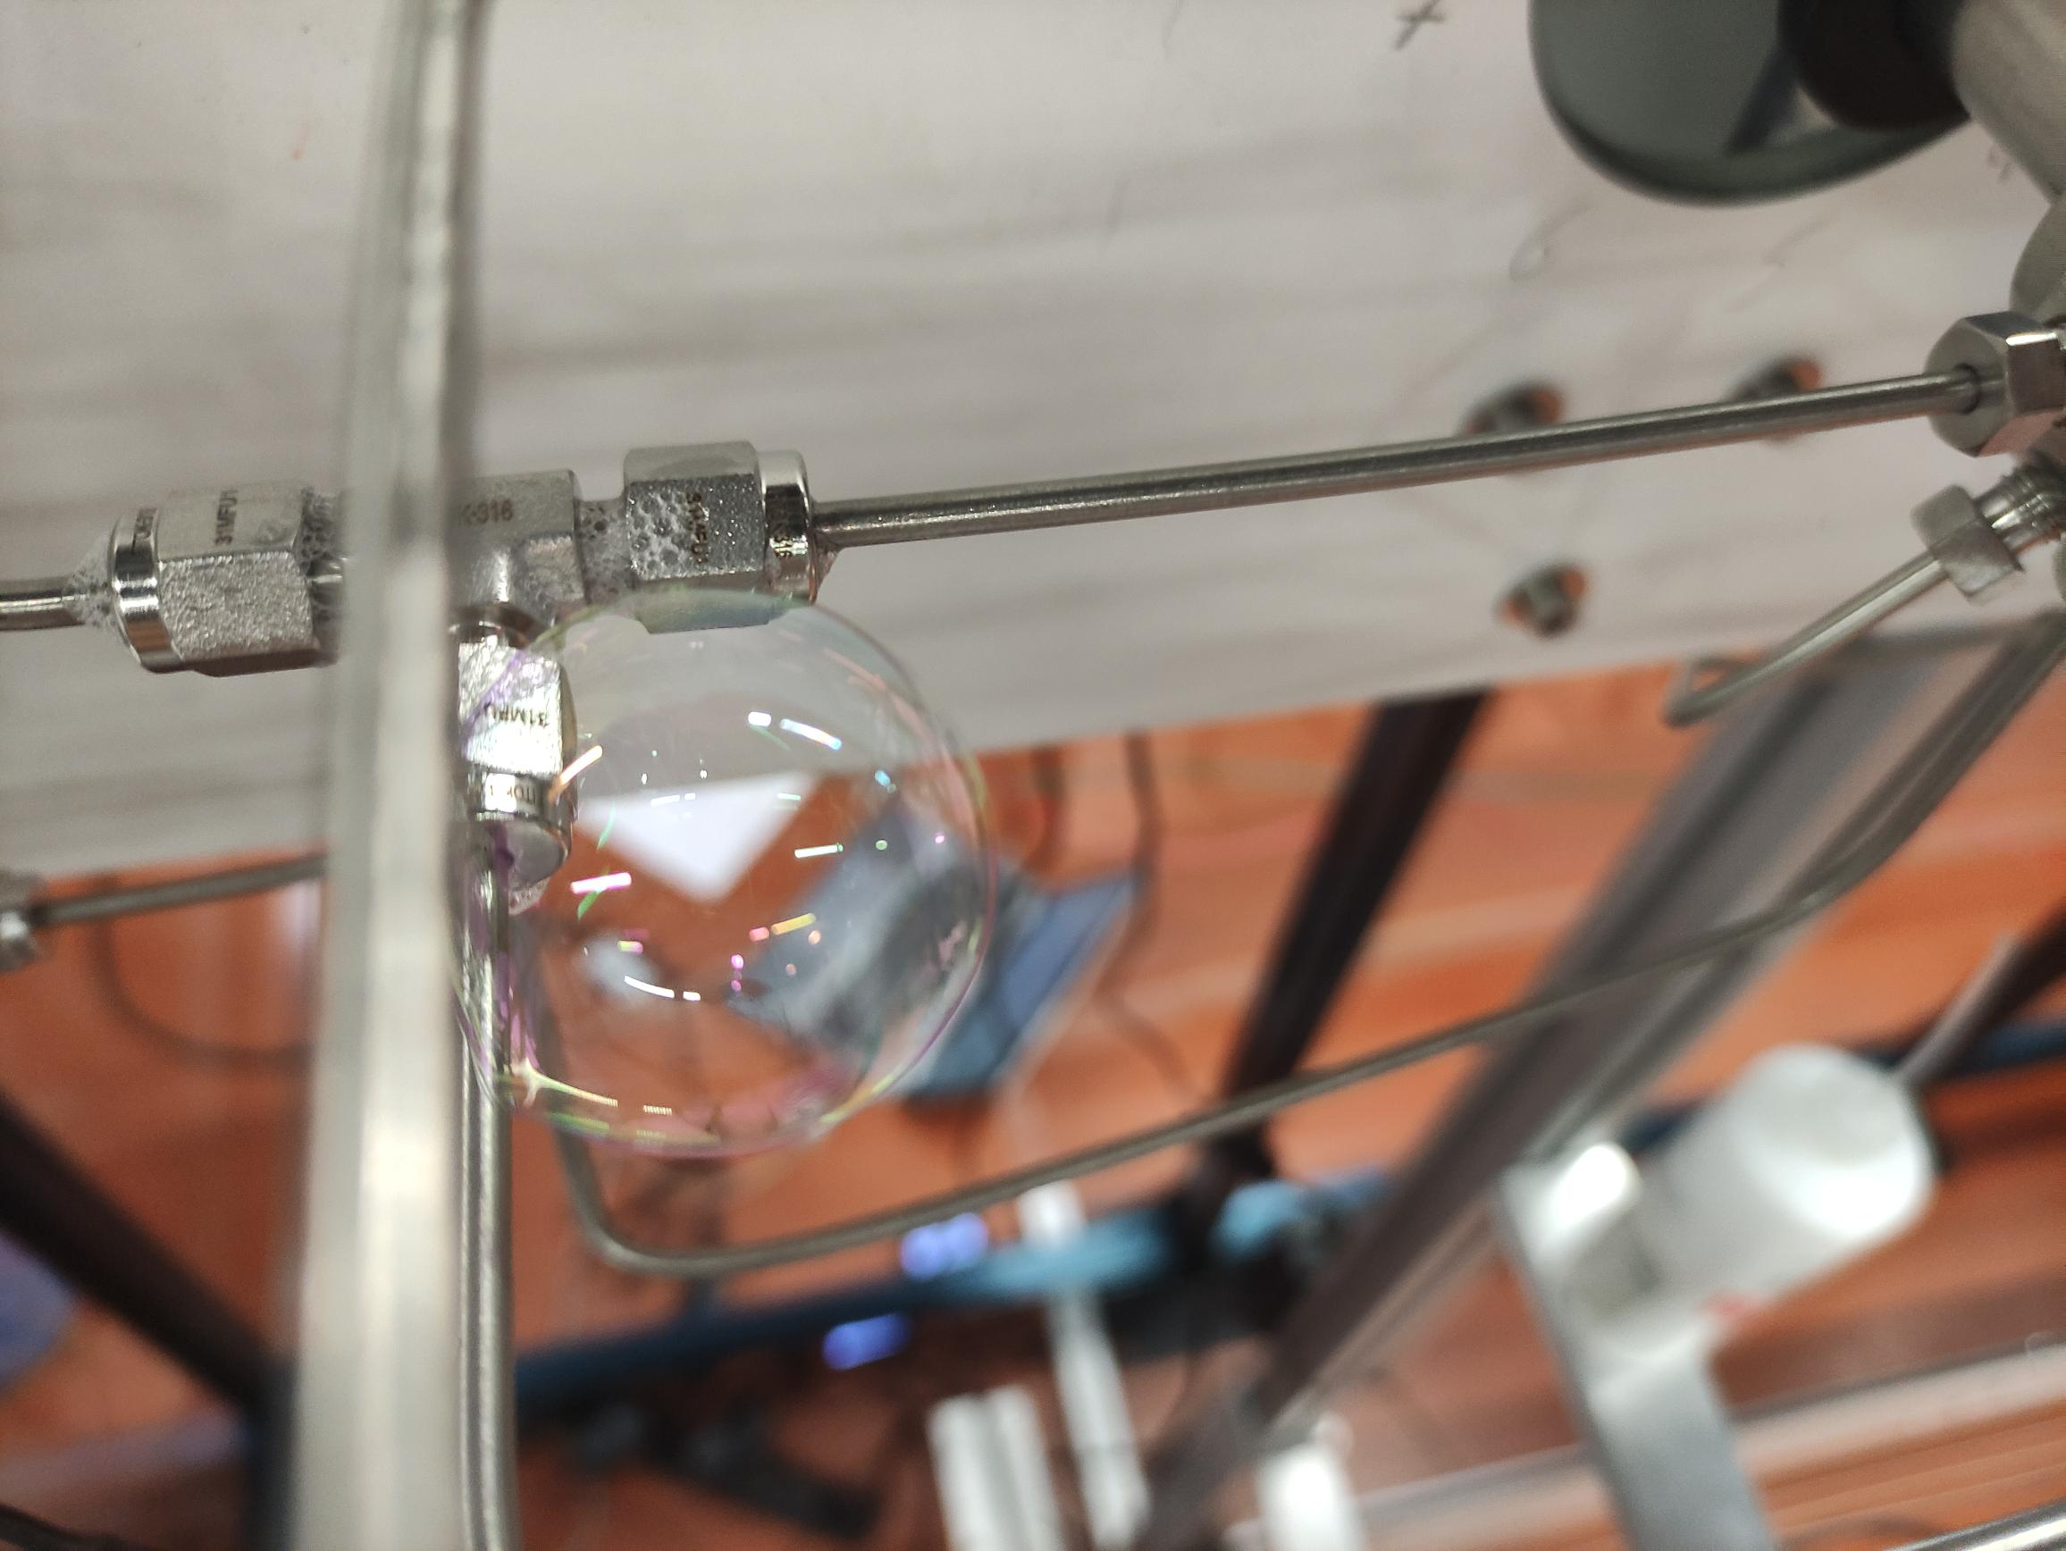
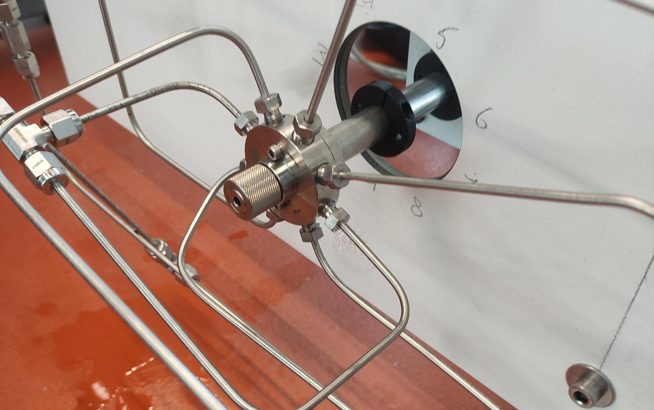
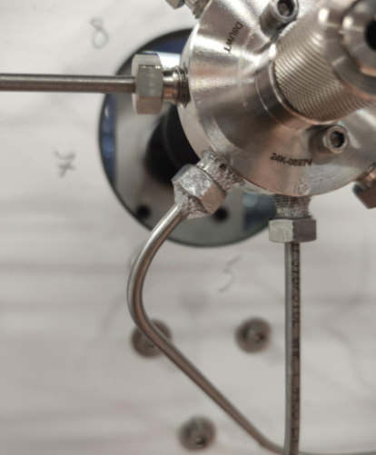
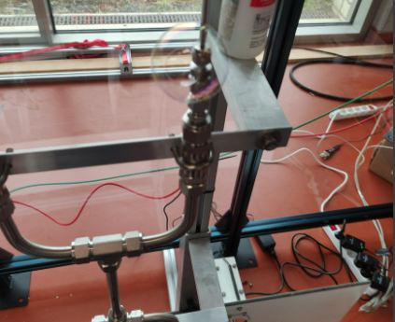
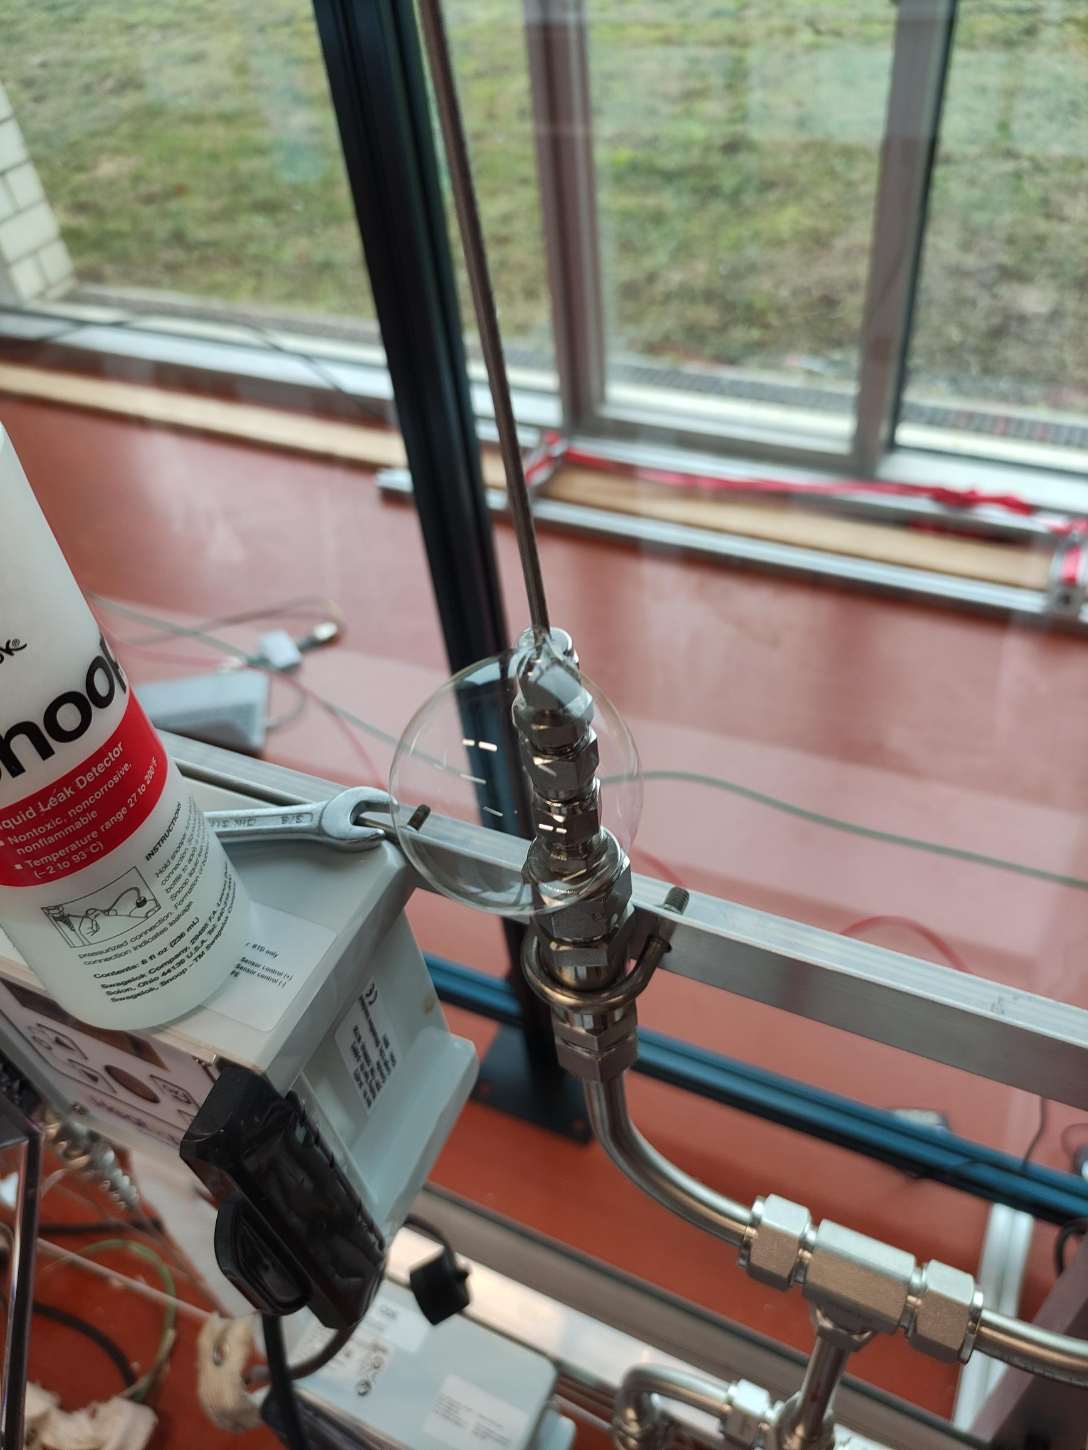
Leak detection and repair

Slide 48
Benchmarking & analysis NH₃ downstream applications

Slide 49
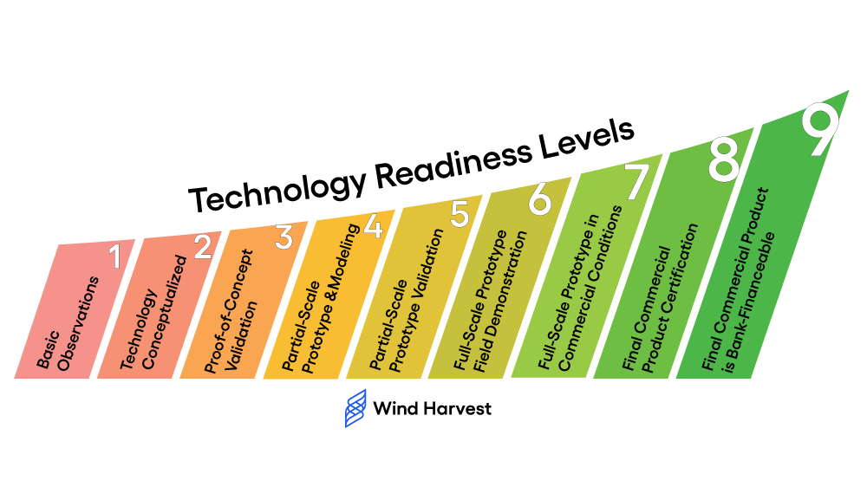
Technical readiness level (TRL) of HyPACT project
Lab-scale experimental demonstration of each component
Virtual demonstration by simulation model
End TRL = 3-4

Slide 50
Alternative cracking technologies
Type |  | Total energy consumption | Total energy recovery | Net energy consumption | Material cost
HyPACT Thermo-catalytic + plasma | Simulation
 | Experimental
Thermo-catalytic | Noble catalysts
 | Non-noble catalysts
Plasma | Cold plasma literature
 | Warm plasma Experimental
Electrolysis | literature
Good
Bad
Notes:
In this figure the energy consumption of the HyPACT process is compared to the state of the art ammonia cracking thermo-catalytic cracking), plasma cracking and ammonia electrolysis. As can be seen, the latter two consume much more energy than thermo-catalytic cracking and the HyPACT process. For plasma, this is because cold plasmas require a lot of energy and the technology of warm plasmas is not yet enough advanced. For electrolysis, the efficiency of the process is very low resulting in a larger amount of energy.
In literature, ruthenium is often proposed as the best catalyst for thermo-catalytic cracking. However, ruthenium is very expensive, hence the red color for material cost for thermo-catalytic cracking. This is however not necessary as has been showed here in HyPACT that less expensive catalysts also perform well enough.

Slide 51
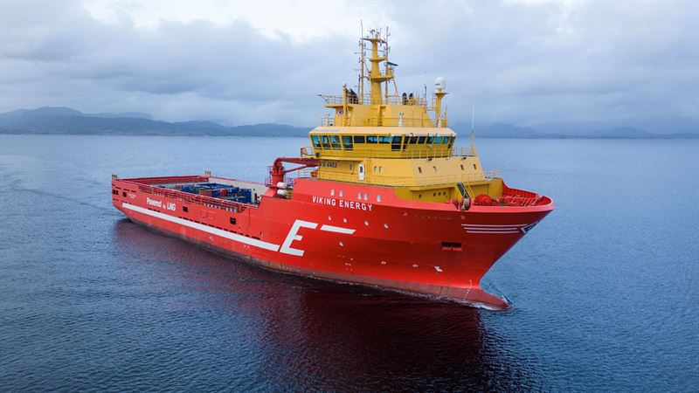
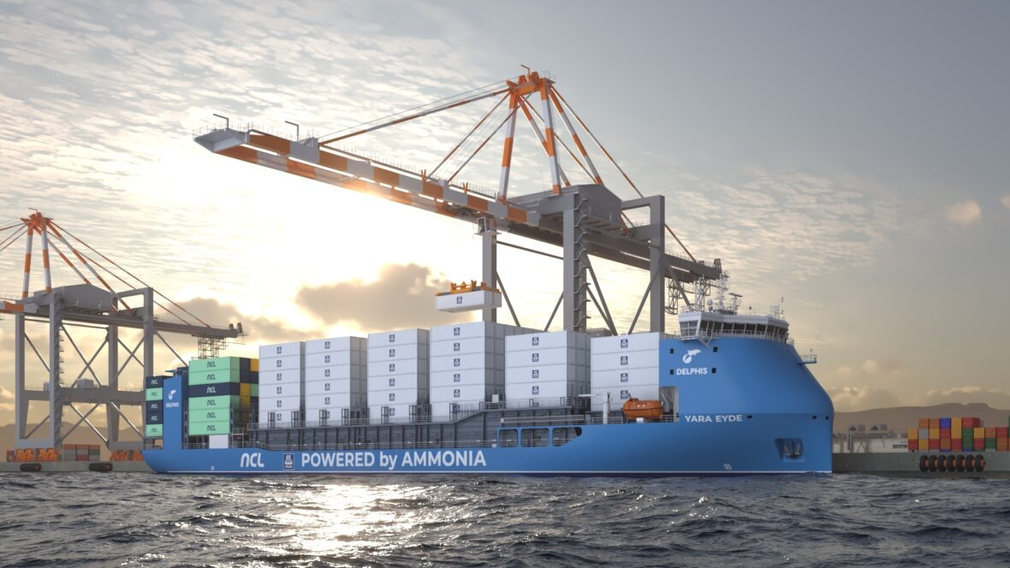
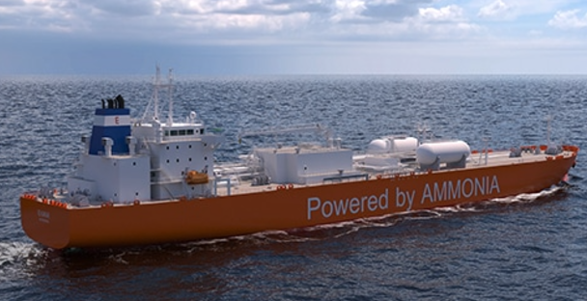
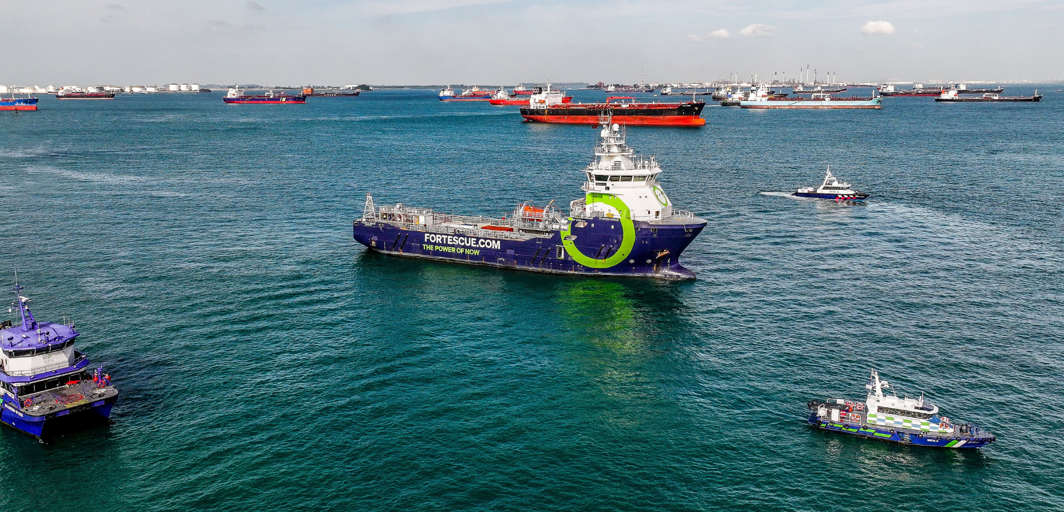
Energy applications of ammonia: Maritime
Notes:
Several ammonia powered vessels are in developing. At the top left we see the Viking Energy from Eidesvik with an ammonia powered engine built by Wärtsilä ready to set sail in 2026. Top right is the Yara Ede by CMB.Tech, Delphis and with support of the NCL (Yara will provide ammonia) also ready by 2026. Bottom left a ship by Exmar and WinGD ready also by 2026. And bottom left we have dual fuel diesel-ammonia powered vessel which already sailed around in Signapore.

Slide 52
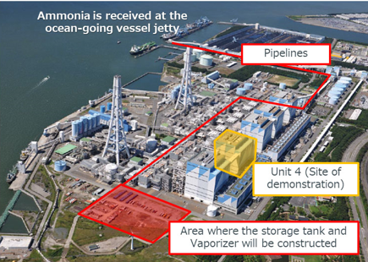
Energy applications of ammonia: Power generation
Notes:
IHI corporation built a cofiring ammonia pilot powerplant and started testing in 2024.

Slide 53
Cracking technology demonstrations
Company | Technology | What
Air Liquide | Thermo-catalytic | Pilot reactor
Topsoe | Thermo-catalytic | Industrial cracker 2 X 2400 MTPD
Duiker Clean Technologies | Thermo-catalytic | SCO → cracking → purify
Amogy | Thermo-catalytic | 200kW – 400kW powerpack
H2Site | Thermo-catalytic + membrane | onboard cracker for electricity
…
Notes:
Several companies have already tested and demonstrated ammonia cracking technologies. Click on the links in the right column to find out more.
Amogy cracks ammonia on board with thermo-catalytic → then adsorber module to purify hydrogen → fuel cell all in the powerpack
H2Site → onboard cracker for electricity for auxiliary consumption
Duiker → S(toichiometry) C(ontrolled) O(xidation) = combustionsystem which destroys ammonia with low NOx formation
MTPD = metric tonnes per day

Slide 54
Future valorization of HyPACT project

Slide 55
The research successes
Precious metal-free catalysts:
Performance ~ State-of-the-art Ru-catalyst NH₃ conversion > 90% at 500°C
Stable over > 50 h
Novel warm plasma reactors for NH₃ cracking:
Performance > literature plasma reactors Energy cost of 120 kJ.mol⁻¹ (for 100% NH₃ feed)
Developed state-of-the-art plasma model with plans for improved reactor design
Zeolite-based H₂ purification
by simulating moving bed
With recirculation of NH₃
Competitive net energy consumption due to smart heat integration
Low material & installation cost
Compatible with renewable energy

Slide 56
One approach of HyPACT NH₃ cracking technology use
Large-scale HyPACT technology use
Large-scale Haber-Bosch NH₃ synthesis
(Pure NH₃ @-33°C)
Transported in vessels via ship
At harbors:
Large-scale cracking of NH₃
Hydrogen product
Transported via pipelines / trucks / …

Slide 57
Stijn Meel
Stijn.Meel@waterstofnet.eu

